Slide 1
Board of Selectman Presentation August 29th, 2023
Kevin Seery
First Selectman

Slide 2
Properties for Purchase
Hathaway Farms
Approximately 114 acres
Oswegatchie Hills
Approximately 119.6 acres
Brainerd Road
Approximately 22.2 acres

Slide 3
Property 1: Hathaway Farms
Remaining parcels of Hathaway Farms
Located Northwest corner of Pattagansett Lake
Approximately 114 acres
East Lyme Land Trust purchased from Hathaway Farms LLC for approximately $2.3 million on September 2022.

Slide 4
Property 1: Hathaway Farms
June 2021: Entire parcel (138 acres) purchased by Hathaway Farms LLC for $1,050,000
April 21, 2022: 9.9 acres of prime waterfront real estate was sold by Hathaway Farms LLC in a private sale for $649,000
September 12, 2022: 6.6 lakefront acres were transferred from Hathaway Farms LLC to Portside Holdings and English Harbor Capital Partners, a related entity to Hathaway Farms LLC. No purchase price indicated.
September 29, 2022: Remaining 122.5 acres were sold to East Lyme Land Trust by Hathaway Farms LLC for $2.3 million
Caveat in purchase agreement regarding reversion of parcels back to Hathaway Farms LLC totaling 12.65 acres leaving approximately 114 acres

Slide 5
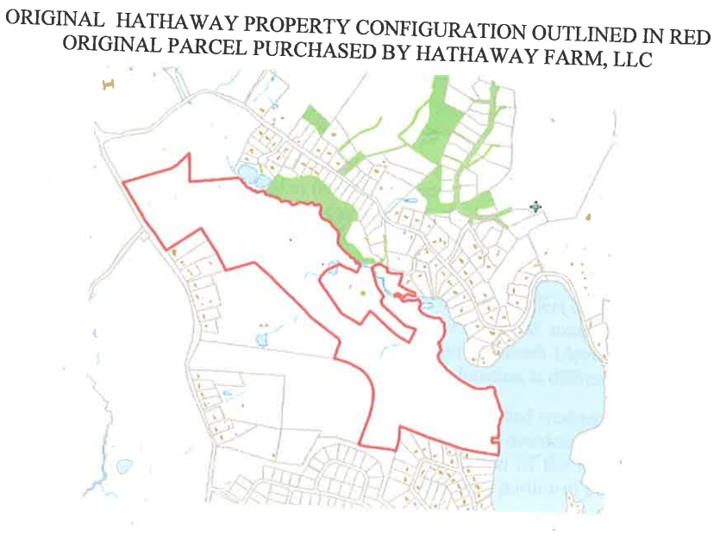
Property 1: Hathaway Farms

Slide 6
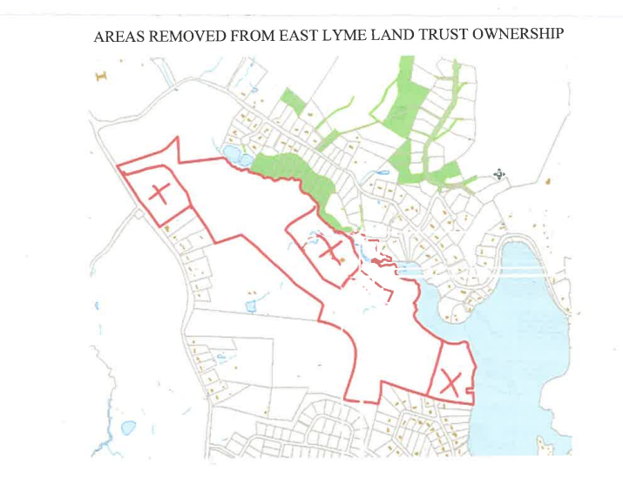
Property 1: Hathaway Farms

Slide 7
Property 2: Oswegatchie Hills
Specified parcels were conveyed to East Lyme Land Trust in 2002-2003 timeframe to be preserved as Open Space
Parcel A
Deed restricted
Parcel B:
Not specified as being preserved for Open Space.
Difficult to develop due to topography
Parcel C
Conservation easement
Parcels D, E and F
Undevelopable parcels of land

Slide 8
Property 2: Oswegatchie Hills Cont’d
Currently there are numerous hiking trails in use in Oswegatchie Hills Nature Preserve including Parcel B
Oswegatchie Hills Nature Preserve Management Plan
Nature Preserve is to be used for the benefit and enjoyment for the people of the State of CT and the general public.
The Uses and Management practices of the management preserve will be those which will not compromise the natural, historical, aesthetic, water shed, or biological significance of the property.
Property was used as collateral by the Land Trust to secure Hathaway Farms LLC property

Slide 9
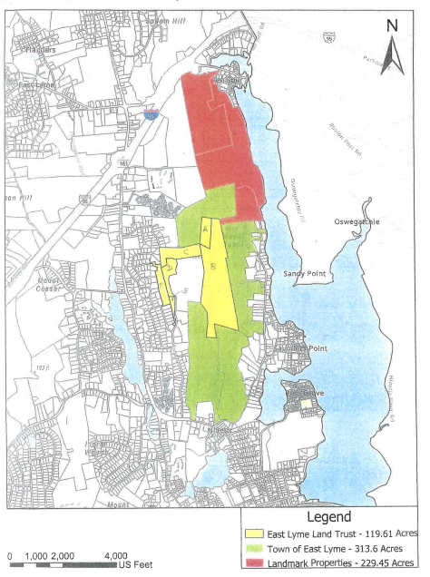

Slide 10
Property 3: Brainerd Road Property
One parcel of land approximately 22 acres
Deeded to Land Trust for Open Space in 2002
Property was used as collateral by the Land Trust to secure Hathaway Farms LLC property
Currently numerous trails accessible from Brainerd road, Giants Neck Beach and Giants Neck Heights

Slide 11
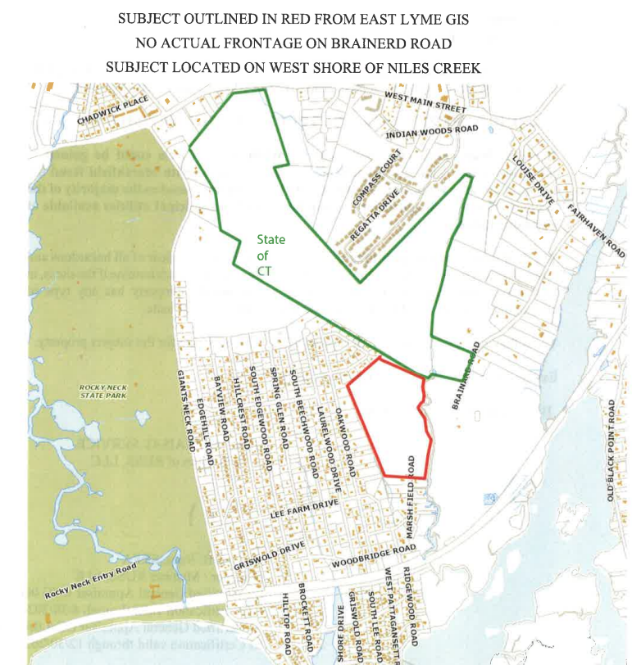

Slide 12
Getting into the numbers…
Purchase Price: $2,250,000 for all three properties
Based on appraisals from Russ Appraisal Services:
Hathaway Farms LLC Parcel: $1,595,000
Oswegatchie Hills Parcels: $575,000
Brainerd Road Property: $125,000
Subtotal: $2,295,000

Slide 13
Funding Options
Purchase Price: $2,250,000
$400,000 DEEP Grant currently being held by the East Lyme Land Trust transferable to the Town of East Lyme.
Must be able to be transferred to the Town of East Lyme.
Open Space Fund Balance Available: $220,000

Slide 14
Financing Options
Option 1: Take from General Fund (GF) Unassigned Fund Balance
Immediate impact to unassigned fund balance
Potential to adversely affect Town’s credit rating
Option 2: Borrow from GF Unassigned Fund Balance
Short term impact at Year End (YE) 2024
Replenished fund balance after YE2024 close, in FY2025.
Potential to affect Town’s credit rating
Option 3: Short term note (roll into bonding next year)
Option 4: Pay out of Bonded/CNR and replenish next year
Town will lose some interest income, but save on expenses

Slide 15
Financing Options Cont’d
Option 4: Pay for purchase out of Bond Fund (or CNR) and reimburse the fund next year when bonds are issued.
Town already expects to issue bonds next year so we can realize savings by waiting
Does not impact General Fund Unassigned Fund Balance

Slide 16
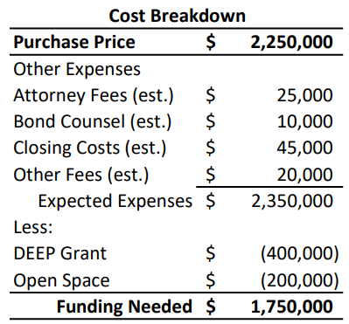
Financing Options Cont’d

Slide 17
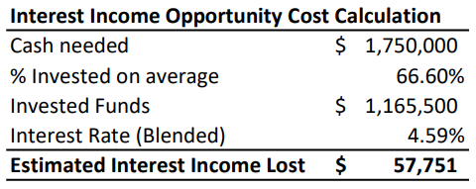
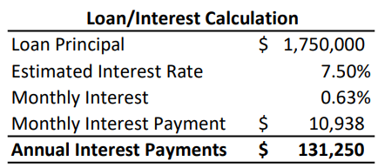
Financing Options Cont’d

Slide 18
Timeline

